Slide 1
Smart Construction Groupware
2026.5.12 (Scheduled) Release Notes

Slide 2
Release Items List
The Smart Construction Groupware update will be released as follows.
Release Schedule (JST): May 12, 2026 (Tue) 19:00 - 22:00 (Scheduled)
NO. | Function | Overview | Details
1 | Folder / File List | Functional improvement. The UI for the file list under Sites, Groups, and Companies has been updated. It is now easier to distinguish between the storage where files are managed and the storage of apps linked to that site. | Please see the following pages for details.
2 | Video Call | Functional improvement. A link button to the site detail page has been added to the video call screen. | Please see the following pages for details.
3 | Bulletin Board | Functional improvement. URLs posted on the bulletin board are now automatically converted to clickable links. | As shown on the left.
4 | Notifications | Functional improvement. A confirmation modal for the Notification List (All), which displays all notifications sent to you, has been added. | Please see the following pages for details.
5 | Notifications | Functional improvement. File operations such as upload and deletion are now notified to site administrators. | The following actions will be notified to users with site supervisor privileges. File upload File edit File / folder operations

Slide 3
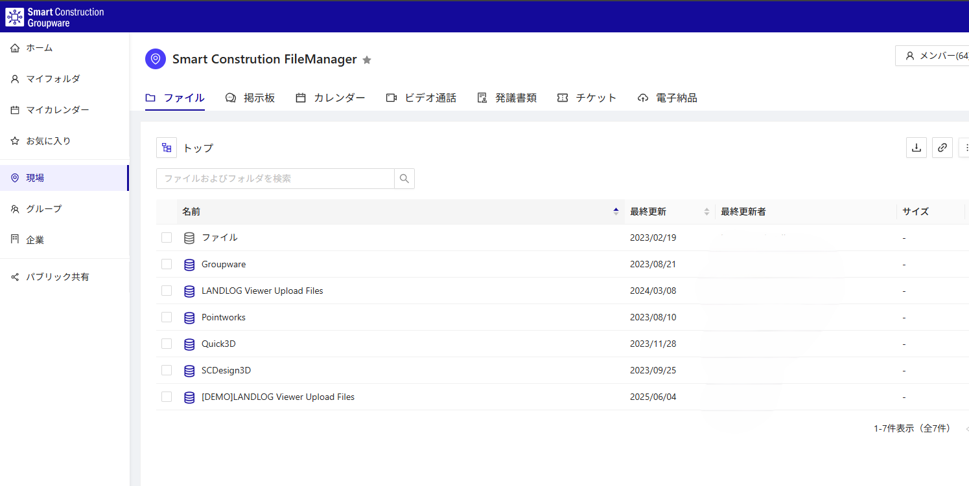

Release Item No.1
No.1
The UI for the file list under Sites, Groups, and Companies has been updated.
The file list shown on the site "Top" has been changed.
Files previously uploaded and saved to Groupware are stored under "Files".

Slide 4
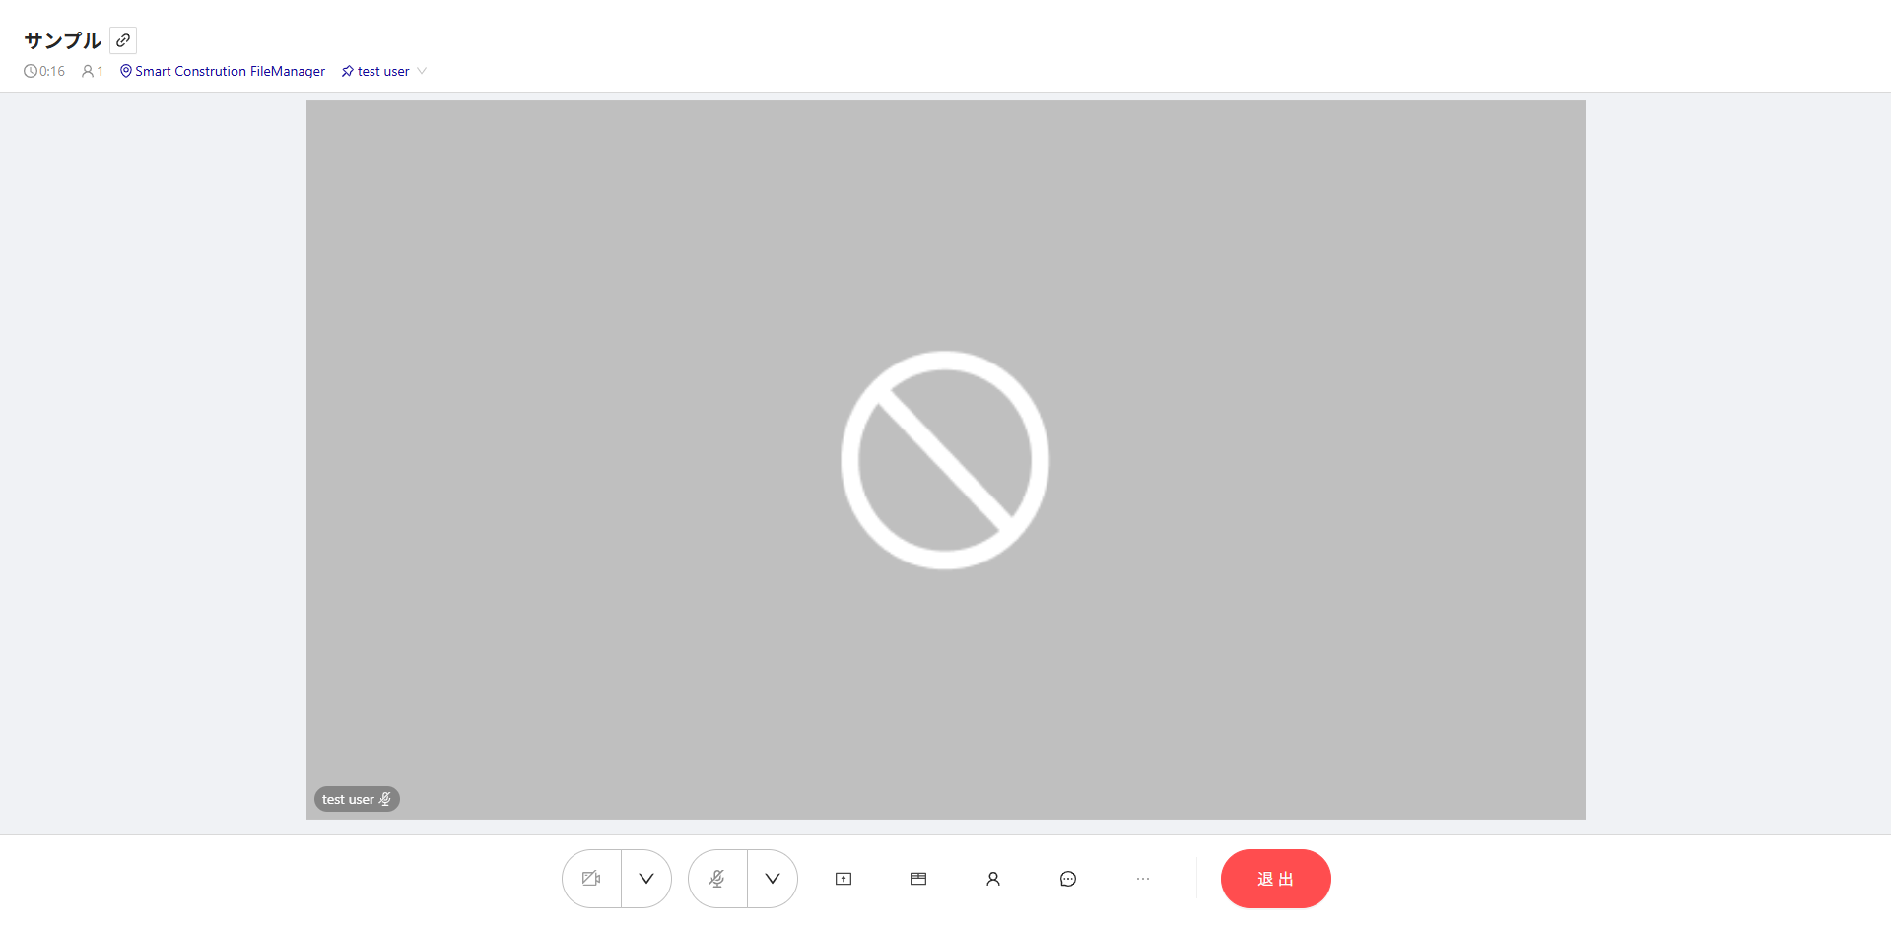
Release Item No.2
No.2
A link button to the site detail page has been added to the video call screen.

Slide 5
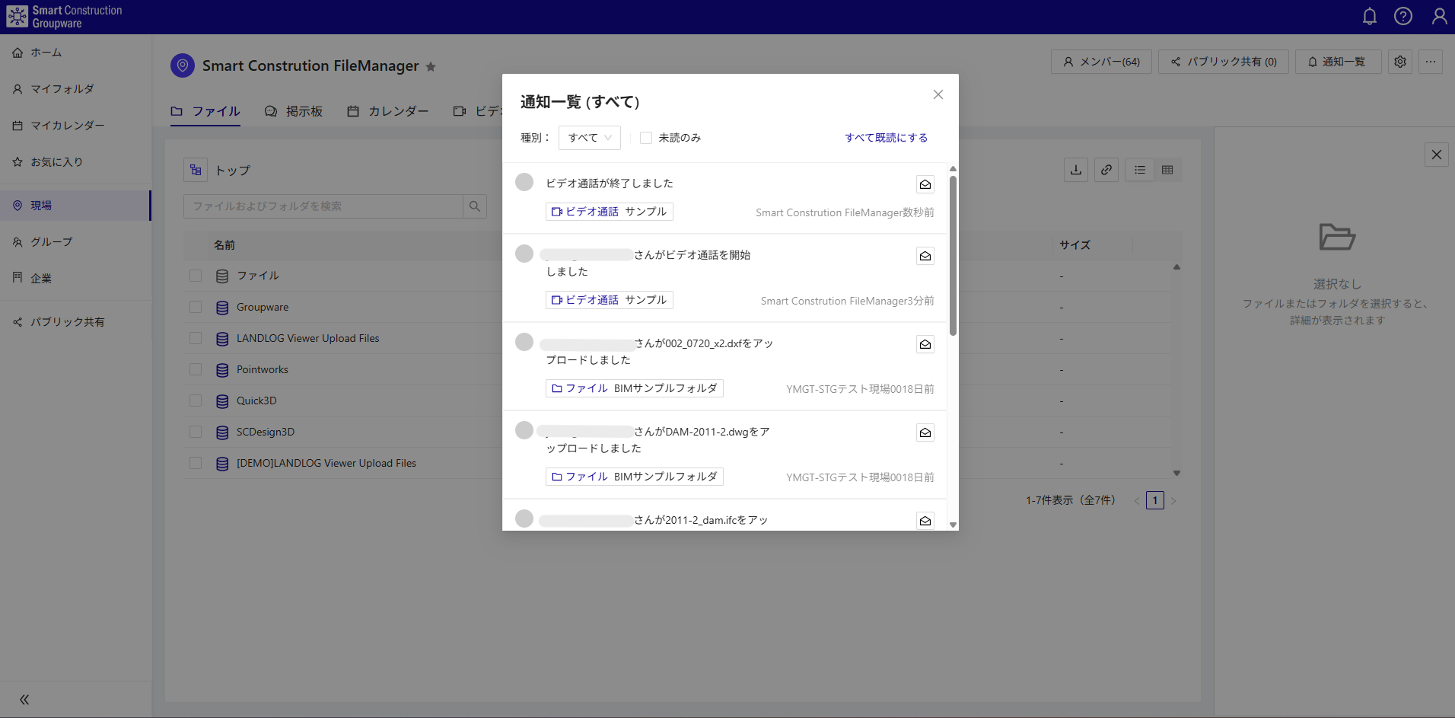
Release Item No.4
No.4
A Notification List (All) that consolidates all notifications sent to you has been added.
Click the bell icon at the top right to display the Notification List (All).

Slide 6
EOF

