Slide 1
Smart Construction Groupware
2026.1.13 ( planned ) release version

Slide 2
Release Item List
The Smart Construction Groupware update will be released on the following dates and with the following content.
Release schedule: Tuesday , January 13th ( Japan time ) ( planned ) 19:00 - 22:00
NO. | function | overview | detail
1 | Header | This is a bug fix. The functions displayed in the header were different for each tab, so we have unified them. | As shown on the left.
2 | Folder/File List favorite | This is a functional improvement. When you hover over each row, more options " ... " will appear, allowing you to operate on folders and files in the same way as with the context menu when you right-click. | Please refer to the explanation on the next page.
3 | Office file display | New features added. Office files has been implemented. | Please refer to the explanation on the next page.
4 | Attachment related | This is a functional improvement. We have set a size limit for uploading attachments and a limit on the number of simultaneous uploads . | Size limit: 50GB Simultaneous uploads: 10 files
5 | Folder/File List | This is a bug fix. When a file is rejected due to security issues , the message displayed was difficult to understand, so we have changed it to display the message "This file cannot be uploaded due to security issues." | As shown on the left.
6 | Bulk bulletin board management | This is a bug fix. Fixed an issue where message board information was not displayed when the screen was displayed. | As shown on the left.

Slide 3
Release Item List
The Smart Construction Groupware update will be released on the following dates and with the following content.
Release schedule: Tuesday , January 13th ( Japan time ) ( planned ) 19:00 - 22:00
NO. | function | overview | detail
7 | Viewer screen | This is a bug fix. The unintentionally displayed Members tab has been hidden and a Related Files tab has been added. | As shown on the left.
8 | Member invitation | This is a functional improvement. We have revised some of the restrictions when inviting members. Fixed to ensure consistency between | As shown on the left.
9 | Video calling | This is a bug fix. Fixed an issue where the on-site icon and favorites icon were not displayed on the video call tab display only. | As shown on the left.
10 | Video calling | This is a bug fix. When duplicating and editing an electronic small whiteboard, the thumbnail image was not displayed correctly. This has been fixed. | As shown on the left.
11 | Video calling | This is a bug fix. Fixed an issue where a duplicate file extension was created when editing a duplicated electronic whiteboard. | As shown on the left.

Slide 4
Release Item List
The Smart Construction Groupware update will be released on the following dates and with the following content.
Release schedule: Tuesday , January 13th ( Japan time ) ( planned ) 19:00 - 22:00
NO. | function | overview | detail
12 | UI improvement | This is a functional improvement. Removed the transparent gray feature that appears when hovering over recently viewed files on the home screen. Adjusted the display interval of hover animations. The UI for the status tags and "→" on the field / group cards has been adjusted. We've adjusted the gap between cards on the home screen so that they are not too far apart. The UI for message board status tags has been adjusted. The headers were not fixed on tabs other than the File tab, so we fixed them. We have made it so that scrolling across the entire page is not possible. The home screen has been adjusted so that it cannot be scrolled horizontally. We have made some adjustments to | As shown on the left.
13 | Point Cloud Editing - Basic Functions | This is a functional improvement. The context menus have been reorganized for each layer to make them more consistent. | Please refer to the explanation on the next page.

Slide 5
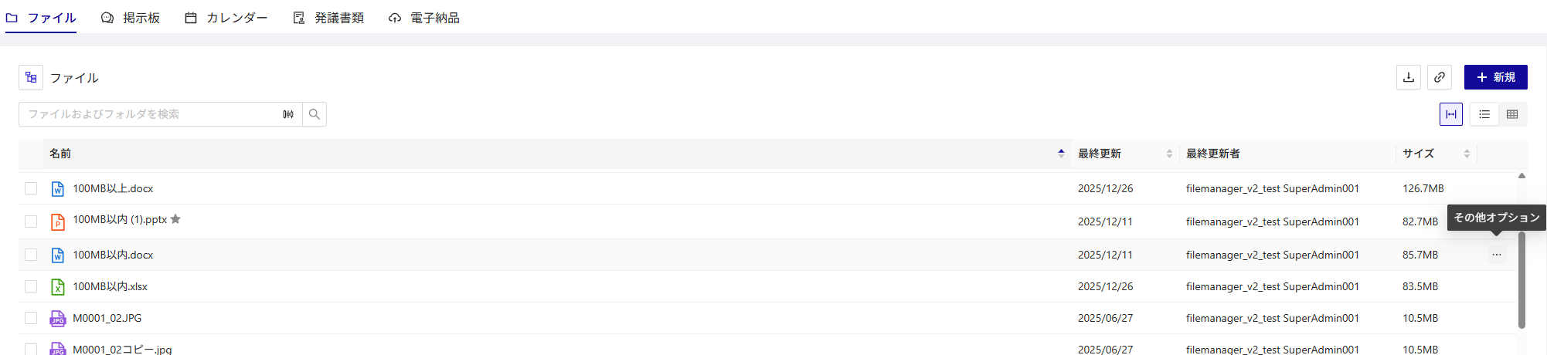
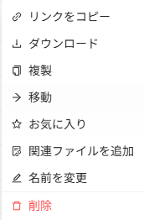
Release Item No. 2
No.2
When you hover over each row, more options " ... " will appear, allowing you to operate on folders and files in the same way as with the context menu when you right-click.
Hovering over a row now displays more options
Pressing

Slide 6
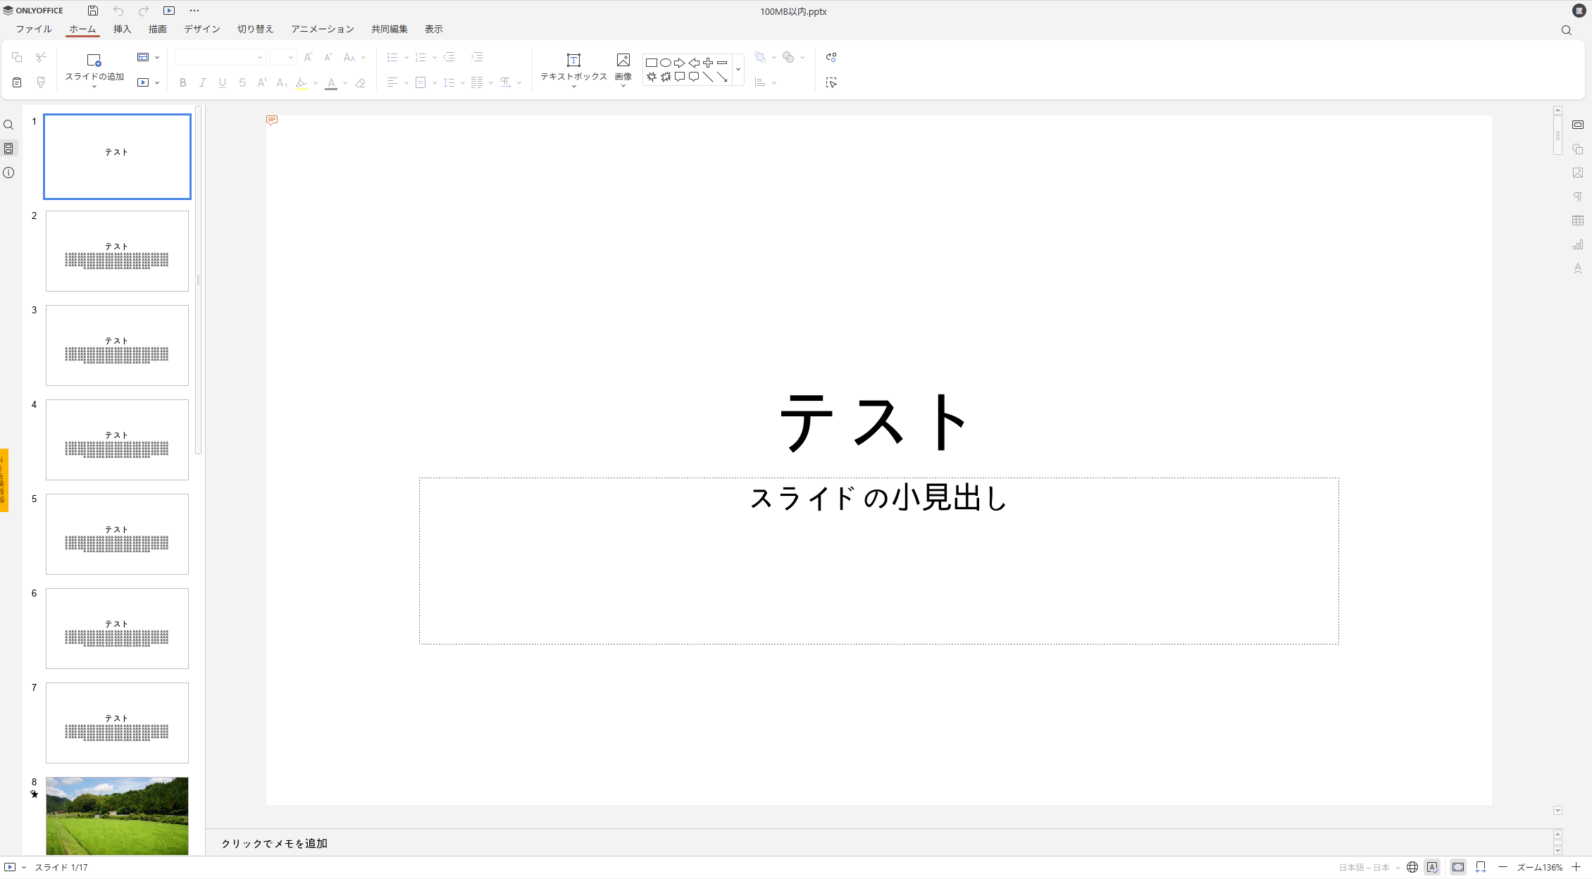
Release Item No. 3
No.3
Office files has been implemented.
It is now possible to edit

Slide 7
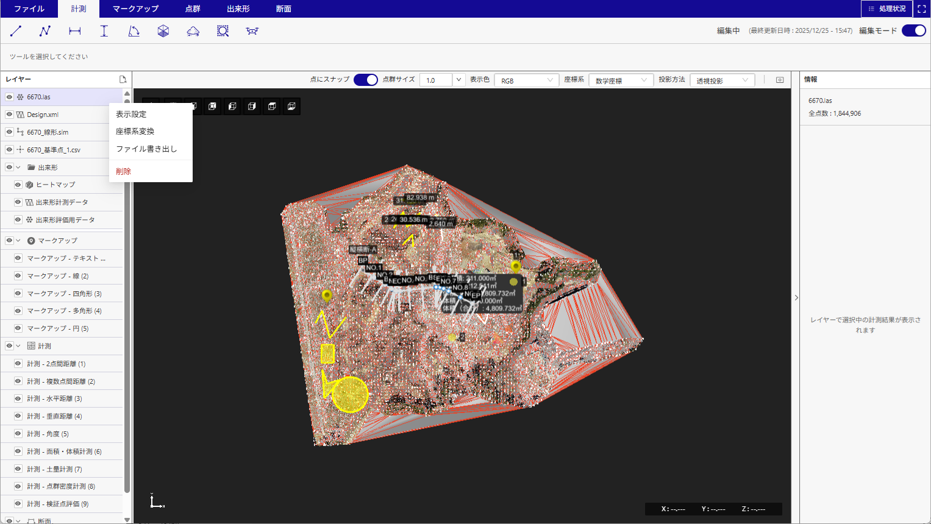
Release Item No. 13
No.13
The context menus have been reorganized for each layer to make them more consistent.
Display Order Rules
・Display settings (viewing)
・Duplicate (Add)
・Change name (edit)
・Conversion (editing / processing)
・Export (external output)
・Layer-specific actions (functions)
・Delete (destructive)
Organize the contents displayed in the context menu.
* See the next page for the display menu for each layer.

Slide 8
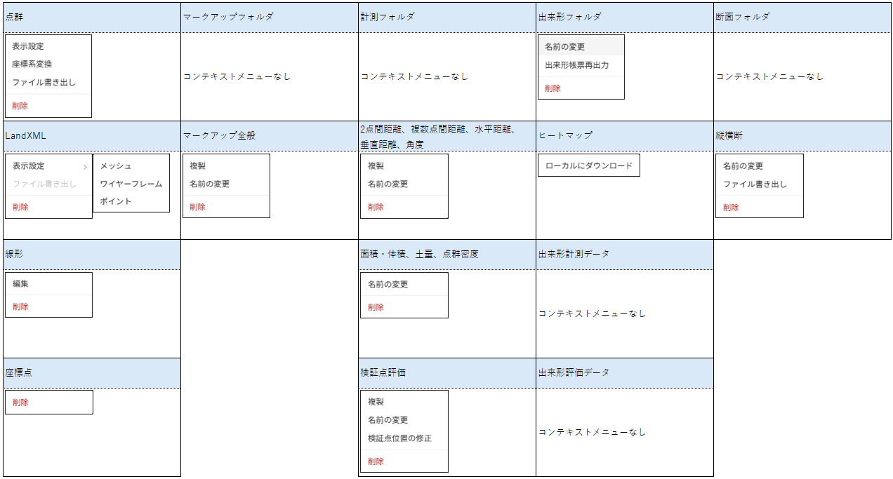
Release Item No. 13
No.13
The context menus have been reorganized for each layer to make them more consistent.
Display menu for each layer

Slide 9
EOF

