Slide 1
Smart Construction Groupware Release information 29.10.2024

Slide 2
Release items list
We will release these contents on the following schedule
Release Schedule：JST 29th, Oct (expected) 13:00～16:00
NO. | Functions | Summary | Details
1 | Groupware Viewer | New feature added LAS files created in the format of a geographic coordinate system can now be viewed. | Please refer to the explanation on the following page.
2 | Groupware Viewer | New feature added According to No.1, it is now possible to transform the coordinate system from the time of acquisition and the state where the point cloud is displayed in the viewport. | Please refer to the explanation on the following page.

Slide 3
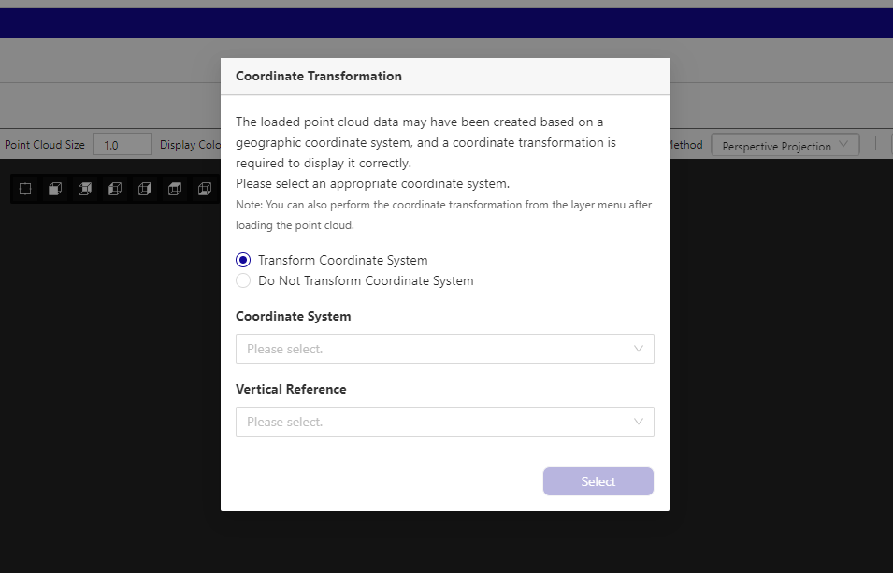
Release item No.1
No.1
LAS files created in the format of a geographic coordinate system can now be viewed.
When displaying the point cloud, a coordinate system conversion modal will be displayed, so please select the appropriate coordinate system and vertical reference from there.
- Radio button “do not transform coordinate system”
If you want to display the coordinate system without transforming it, select this one. * Even point cloud data that does not require coordinate system transformation may have this modal
Refresh button
If you have performed a coordinate system transformation, you will have to wait a few moments and a button will appear in the viewport to refresh. After refreshing the viewport, you can view the point cloud.
・Select button
The transformation of the coordinate system will begin by selecting the appropriate coordinate system and perpendicular origin for the LAS file in the geographic coordinate system that you want to open.

Slide 4
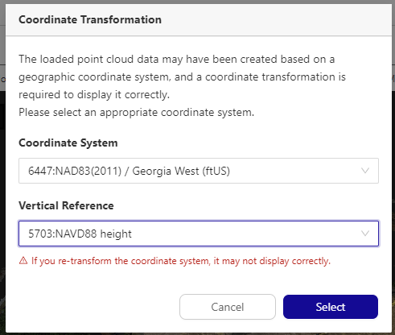
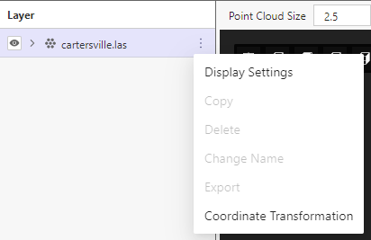
Release item No.2
No.2
Even when viewing a point cloud in the viewport, you can now transform the coordinate system.
Coordinate transformation button
By pressing here, the right coordinate system transformation modal will be displayed
Coordinate transformation modal
The same procedure as item No. 1 on the previous page can be used to transform the coordinate system

Slide 5
EOF

