Slide 1
Smart Construction Groupware
2026.2.9 ( planned ) release version

Slide 2
Release Item List
The Smart Construction Groupware update will be released on the following dates and with the following content.
Release schedule: Monday , February 9th ( Japan time ) ( planned ) 1 9:00 to 22:00
NO. | function | overview | detail
1 | External file sharing function | New features added. External file sharing feature implemented | Please refer to the explanation on the next page.
2 | Login screen | This is a bug fix. There was an issue where you could not log in under certain conditions, so we have fixed it so that you are redirected to the login screen. | This issue occurs with a low probability when you perform the following operations : 1. Open two tabs of the same domain in your browser . 2. Close the browser in that state. 3. Restart your browser and both tabs will be restored at the same time.
3 | Help Menu | This is a functional improvement. The links to the manual and terms of use in the Help menu have been changed. We have also removed the link to our privacy policy. | As shown on the left.
4 | Bulk download function | This is a functional improvement. You can now choose whether or not to include system folders when downloading in bulk. | As shown on the left.
5 | General | This is a bug fix. Fixed an issue where the screen width would change when scrolling quickly while a tooltip was displayed. | As shown on the left.
6 | General | This is a functional improvement. For screens where multiple selections can be made, such as folder/file lists, ① You can now select a range by using ② You can now select multiple items by pressing 3) The click detection area of the check box has been enlarged. | As shown on the left.

Slide 3
Release Item List
The Smart Construction Groupware update will be released on the following dates and with the following content.
Release schedule: Monday , February 9th ( Japan time ) ( planned ) 1 9:00 to 22:00
NO. | function | overview | detail
7 | System Folder | This is a bug fix. We have fixed the issue where | As shown on the left.
8 | Coordinate system transformation | New features added. Coordinate system transformations can now be performed | Please refer to the explanation on the next page.

Slide 4
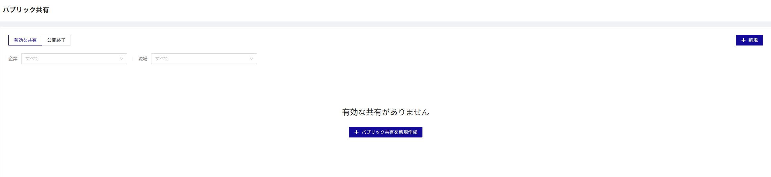
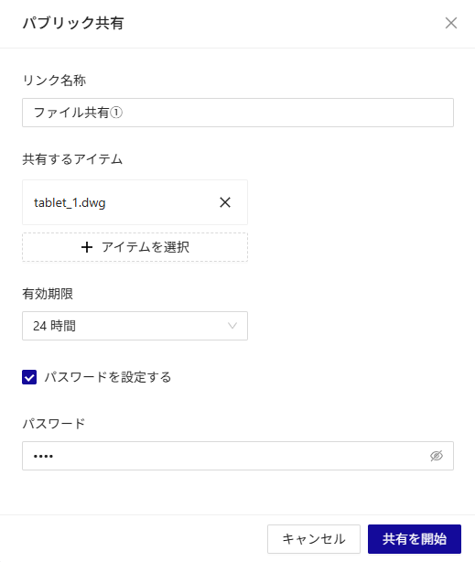
Release Item No. 1
No.1
Introducing external file sharing
Public sharing ( a function that issues a URL that allows downloading of files for a certain period of time)
You can share up to
Even if there are multiple files in a folder, the number of selected files will be counted as
The expiration date can be set to a maximum of
You can set whether or not to use a password.
If a password is required, you will be asked to enter it when

Slide 5
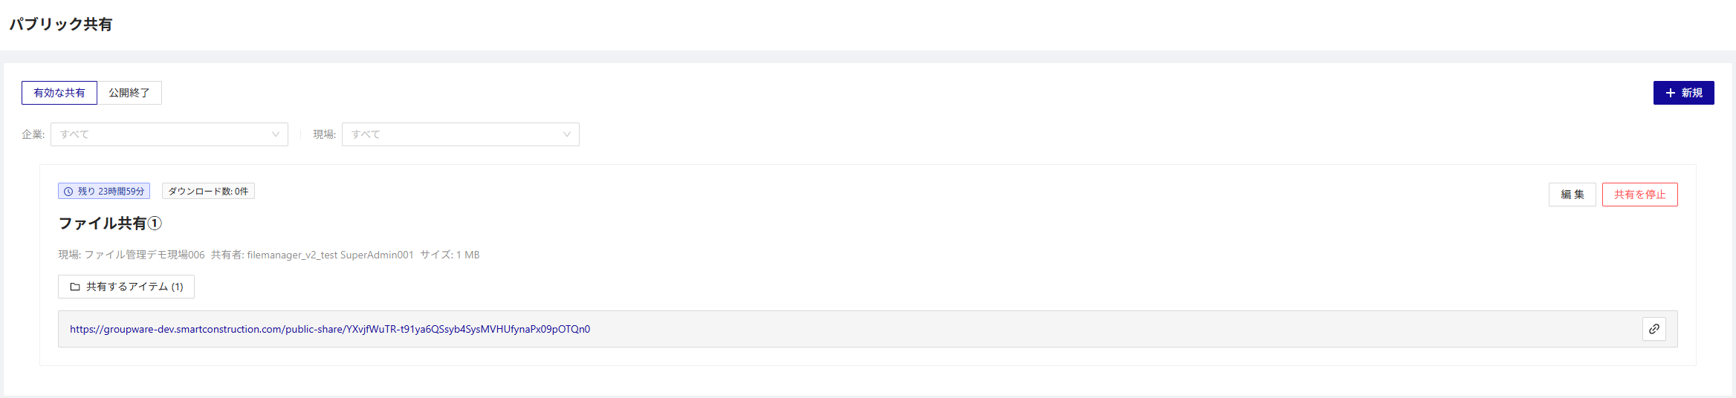
Release Item No. 1
No.1
Introducing external file sharing
Public Sharing
The created share will be displayed on the list screen.
download time and number of downloads will be displayed.
You can move to the download screen.
You can stop sharing or delete it without leaving a history.
If the expiration date has expired or sharing has been stopped, you will be redirected to the end of sharing page.

Slide 6
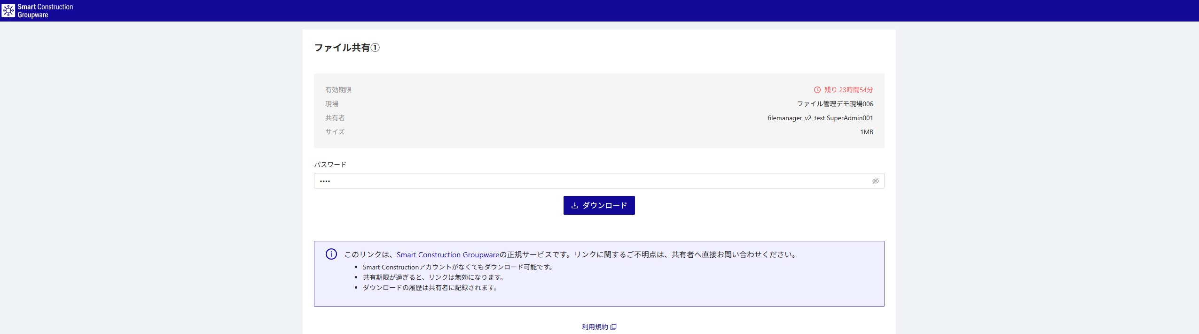
Release Item No. 1
No.1
Introducing external file sharing
Download screen
You can download files as though you do not have Smart Construction account.

Slide 7
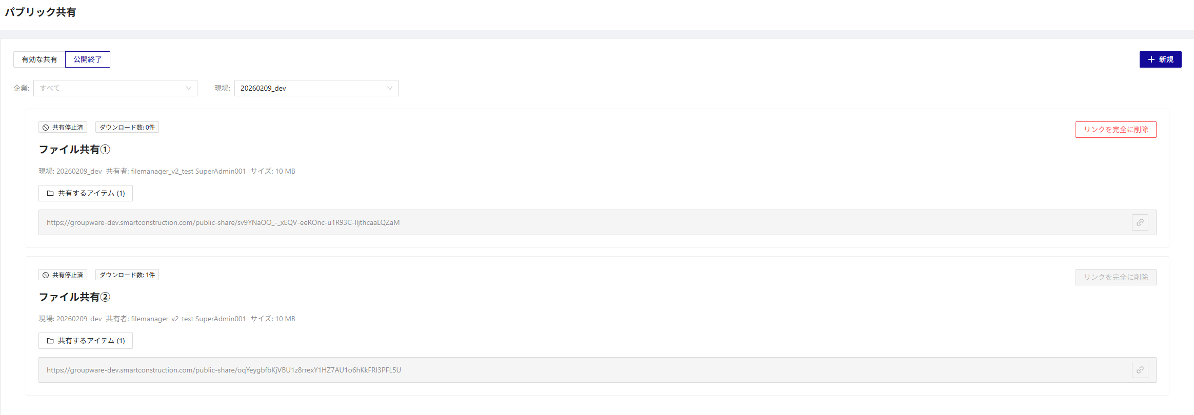
Release Item No. 1
No.1
Introducing external file sharing
If the expiration date has passed or sharing has been stopped, you will be redirected to the end of publishing page.
Public sharing (no longer available)
download history, you can delete it without leaving a history.
a download history, you cannot delete the history.

Slide 8
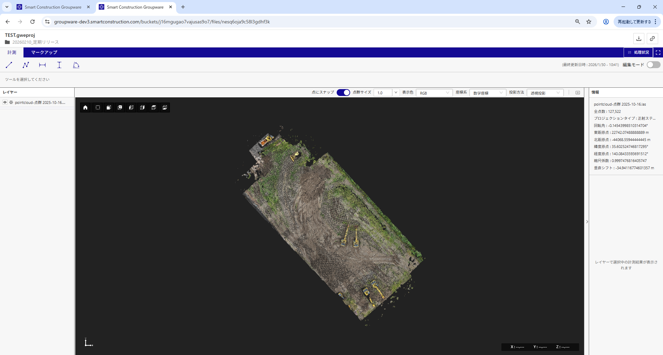
Release Item No. 8
No.8
Coordinate system transformations can now be performed using localization files.
Localization information used to convert the coordinate system
The point cloud is displayed after coordinate system transformation using the localization information.
* Details and screen images for each conversion method are provided on the next page.

Slide 9
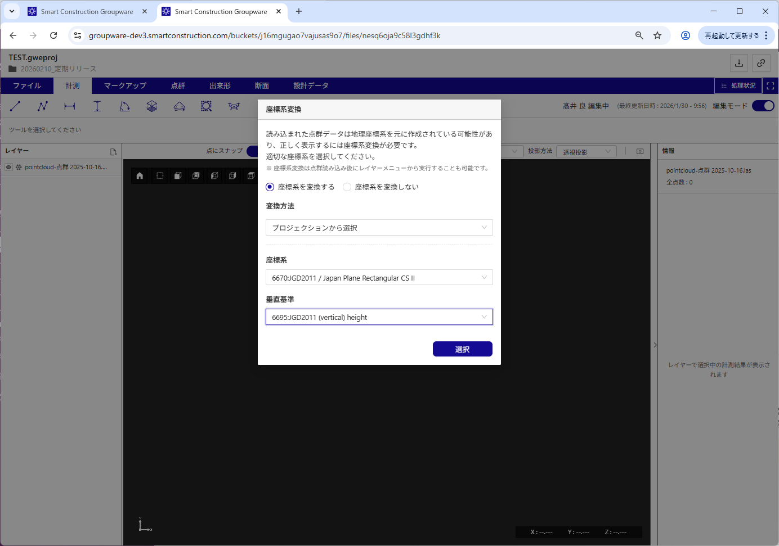
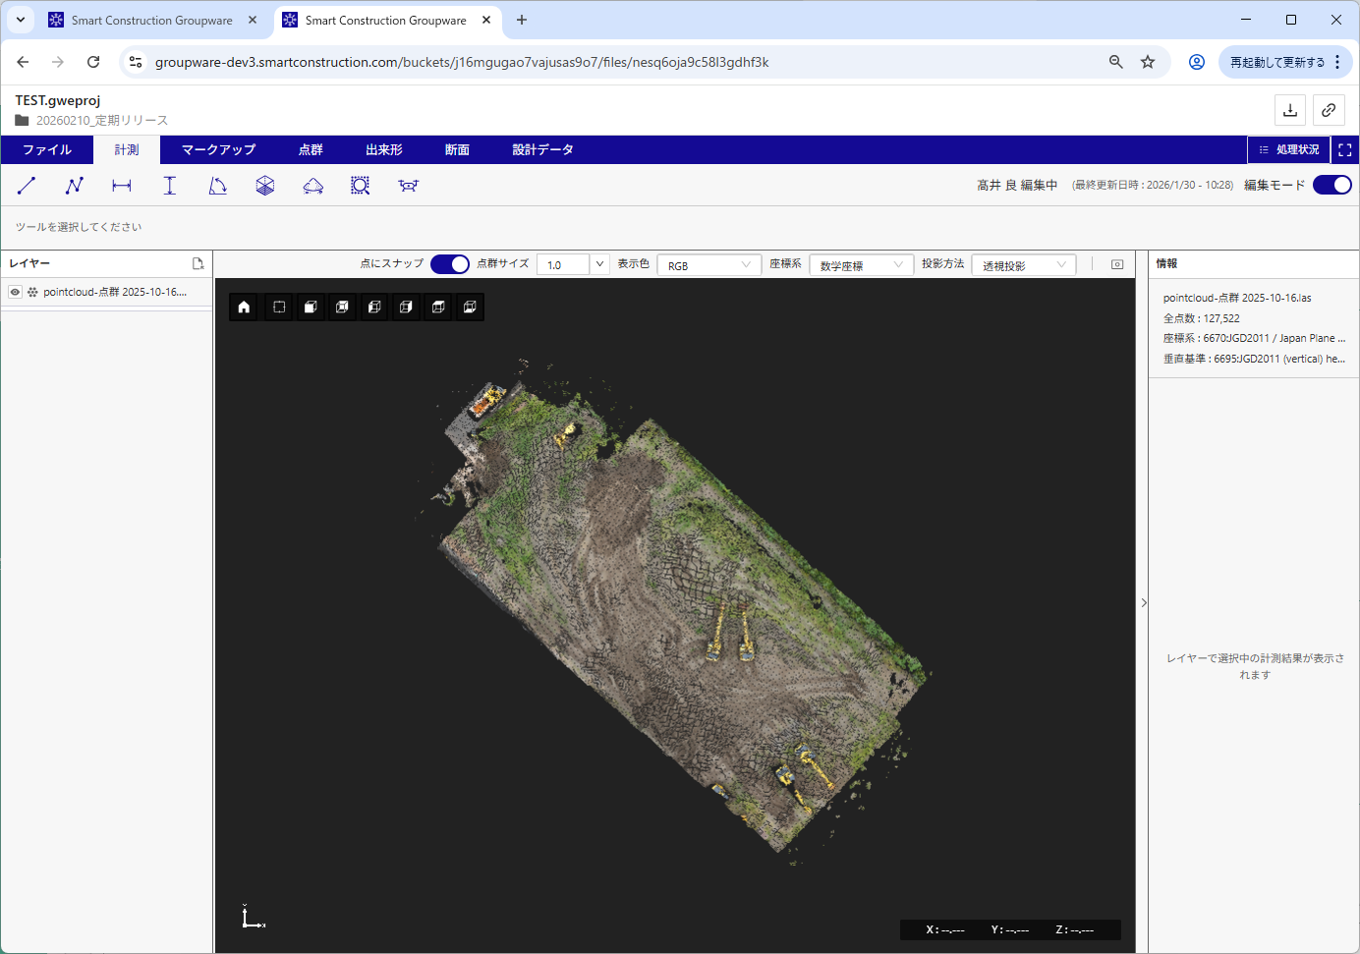
Release Item No. 8
No.8
Coordinate system transformations can now be performed using localization files.
"Select from projection" * Existing function
Projection information used to convert the coordinate system
You can perform coordinate system conversion by specifying the "coordinate system" and "vertical reference".
The point cloud is displayed transformed using the projection information.

Slide 10
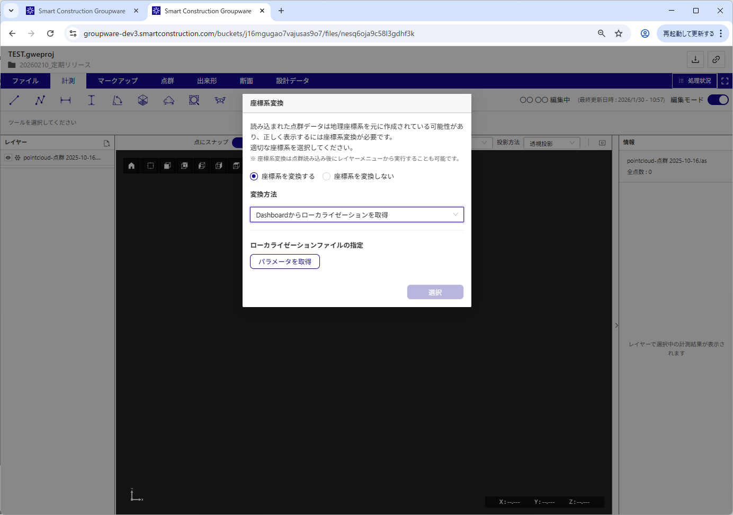
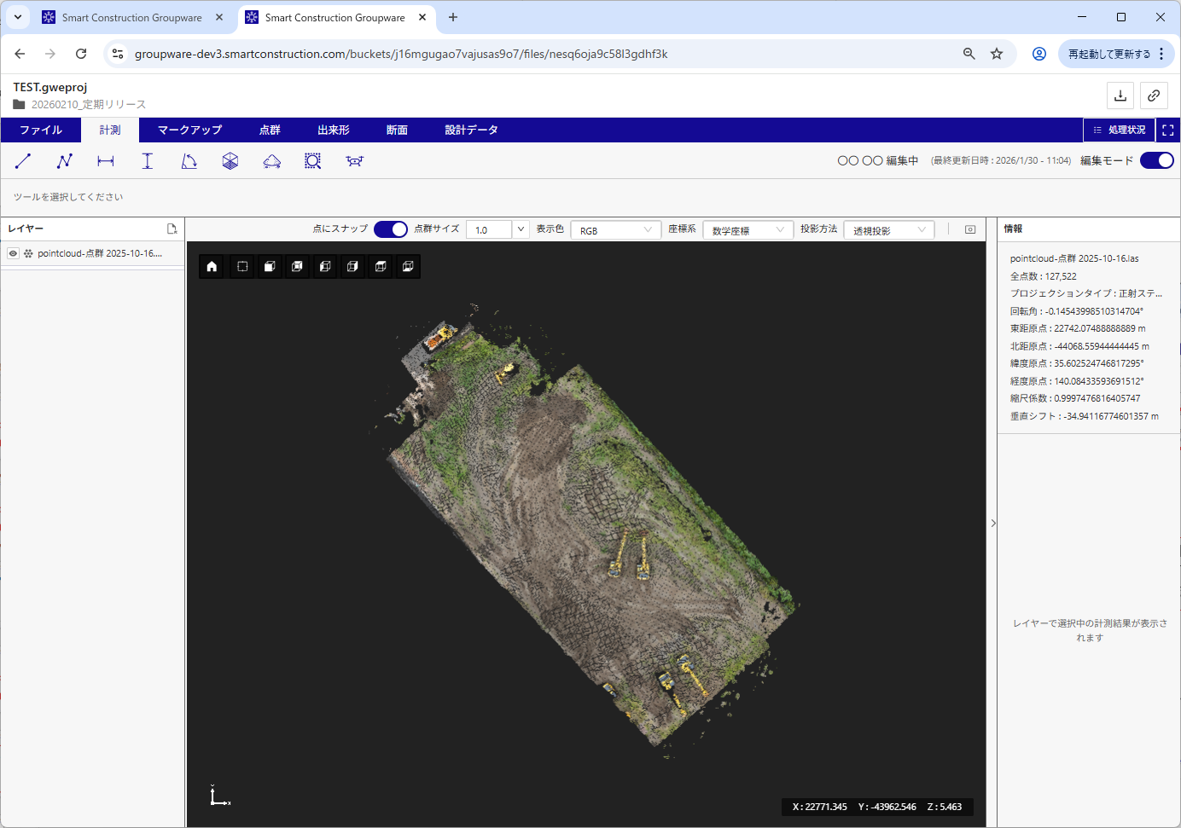
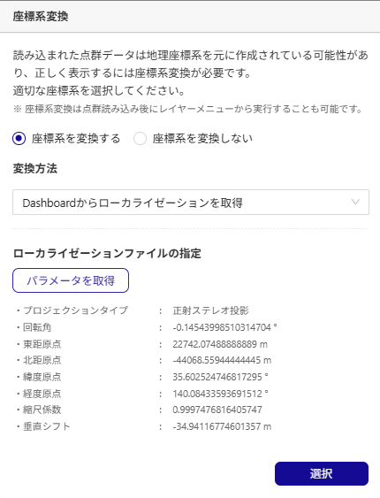
Release Item No. 8
No.8
Coordinate system transformations can now be performed using localization files.
" Get localization from Dashboard " * New feature
Press the Get Parameters button
Localization information used to convert the coordinate system
Press the Get Parameters button to retrieve localization information from
The obtained localization information can be used to perform coordinate system transformation.
The transformed point cloud using the localization information is displayed.

Slide 11
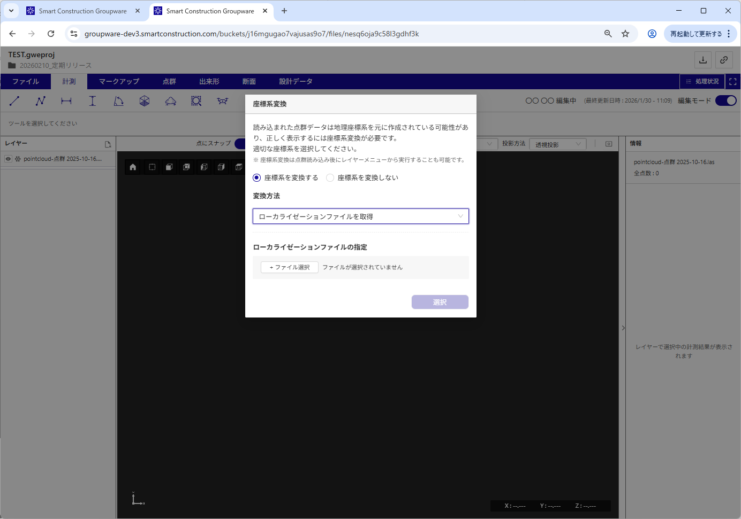
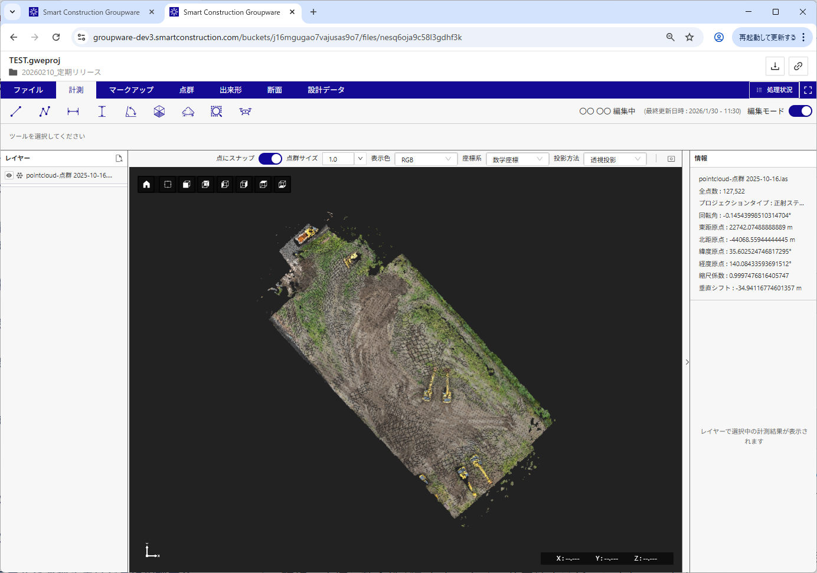
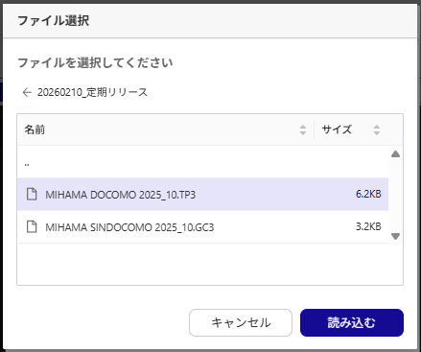
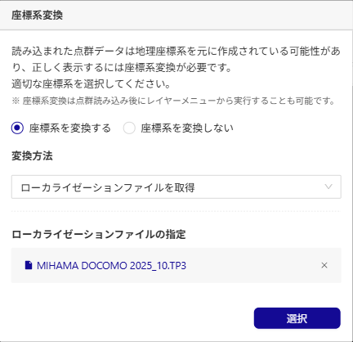
Release Item No. 8
No.8
Coordinate system transformations can now be performed using localization files.
"Get localization files" * New feature
Press the file selection button
Localization information used to convert the coordinate system
The transformed point cloud using the localization information is displayed.
Press the file selection button to select the localization file.
You can use the selected localization file to perform coordinate system transformations.

Slide 12
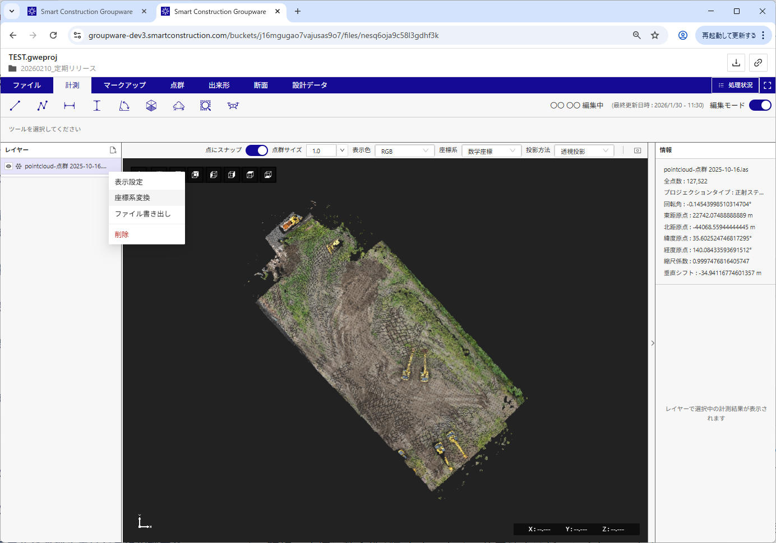
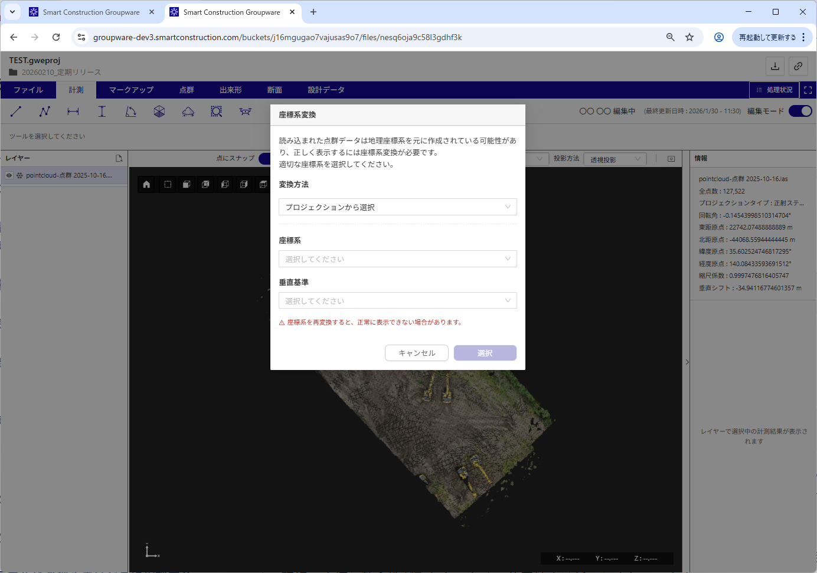
Release Item No. 8
No.8
Coordinate system transformations can now be performed using localization files.
Coordinate system retransformation
You can re-transform the coordinate system from the context menu of the point cloud layer.

Slide 13
EOF

